Slide 1

Adult Social Care Charging Policy Waivers, Hardship & Financial Appeals Process
Please note that this session will be recorded!

Slide 2

Introduction & Background
From April 2026, the Council will implement the updated Adult Social Care Charging Policy. This outlines how NCC assesses and charges for care and support services, ensuring that charges are fair and reflect the individual's ability to pay.
As part of these changes, a new appeals process is being introduced for people who do not agree with the outcome of their financial assessment.
The updated policy also strengthens support for staff by providing a clear definition and criteria for financial hardship, along with a consistent approach to how waivers are considered and approved across the department.
In 2025/26, to date, over £72k has been approved in waivers, with over 90% being a result of complaints or financial hardship.
Within this briefing we will cover:
Definitions
What’s New – Processes & procedures
Financial Hardship
Financial Appeals
Waivers – New Mosaic form, process and approvals
Timeline & Next Steps
Where to find further information & guidance
Opportunity to ask questions…..

Slide 3

Definitions
Hardship:
Financial hardship is defined as: “Paying the assessed charge or flat rate charge would cause you or your dependents to forgo basic needs and necessities, such as housing, food, utilities, transport, clothing, essential disability costs, and debt repayments that would have a serious detrimental effect on health and wellbeing”.
Financial Appeal:
An appeal against the outcome of financial assessment is a formal process where individuals disagree with the assessment outcome and seek to have it reconsidered – These will be handled by ACFS.
Complaint:
A formal complaint in adult social care is an expression of dissatisfaction—made verbally or in writing—about the actions, decisions, standard of service, or lack of action by adult social care services, their staff, or those acting on their behalf, which requires investigation through the NCC complaints procedure.
Waiver:
A waiver is a request for a reduction or exemption of charges for care services. It could apply to assessed care charge contributions, top up fee, or a flat rate charge e.g. transport, financial
services fees or some TEC charges.
Write Off:
Different to a waiver (but often confused) a write off is the process of removing a debt from the council’s financial records, typically done when a debt is deemed unlikely to be repaid.
Flat Rate Charges:
Standard charges applied for certain services e.g. transport arrangement fees, that are not
Subject to a financial assessment.

Slide 4
What’s New?
A streamlined waiver request and approval process, aligned with the new levels of authorisation and connected to the Hardship, Appeals and Complaints processes.
The creation of a new Financial Waiver Request Form, within Mosaic.
The introduction of a new Hardship definition and criteria, along with a new hardship application process, for flat rate charges.
A new Financial Appeals Process (related to financial assessment outcomes), which will be managed by ACFS.
New reports, within the BI Hub, which will:
- Show the number of waiver requests approved,
- Show the number of waivers pending approval,
- Allow us to analyse and identify trends,
- Link to wider ASCH reporting dashboards.

Slide 5
How it all fits together….
Hardship Application (Flat Rate Charges)
Financial
Appeal
Outcome
Complaints
Errors
Conversations, visits etc
Decision to proceed with a waiver request
Waiver Process

Slide 6
Financial Hardship
31% of waivers, approved in 2025/26, have been due to financial hardship.
As a reminder…
Financial hardship is defined as “paying the assessed charge or flat rate charge would cause you or your dependents to forgo basic needs and necessities, such as housing, food, utilities, transport, clothing, essential disability costs, and debt repayments that would have a serious detrimental effect on health and wellbeing”.
Statutory Principle:
Under the Care Act 2014, no one should be charged more than they can reasonably afford for care.
This is operationalised by ensuring individuals retain a Minimum Income Guarantee (MIG) after charges, safeguarding essential living costs.​
Therefore, if paying the flat rate charge or assessed charge would cause financial hardship, we will consider offering a reassessment and / or waiving / reducing the assessed charge or flat rate charge.
Financial hardship is not new! People have always told us that they struggle to afford charges, such as flat rate fees or their assessed contribution. Until now, we haven’t had:
A clear definition of what Hardship is..
A clear criteria to help us determine if people are experiencing hardship…
A process for handling these requests….
Until now…..

Slide 7
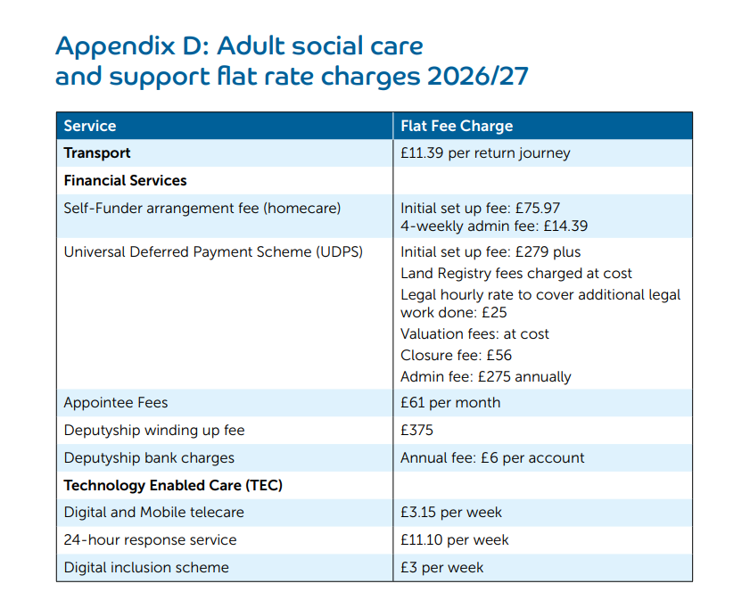
Financial Hardship Process - Overview
There are two processes, one for assessed charges and one for flat rate charges…..
Appeal against FA Outcome
3 stage approach (ACFS)
If waiver is required….
Community Team identifies potential hardship / Person contacts CSC
Hardship Form (or Link) sent by CSC / Community Team
Completed form received and assigned to appropriate team
Form assessed against hardship criteria
If Waiver is required..
1)
2)
Financial Hardship (Assessed Charge / Contribution)
(Managed by ACFS)
Financial Hardship (Flat Rate Charge)
The full hardship process, with all supporting guidance documents, will be available in the Policy Library.
WAIVER PROCESS

Slide 8
Hardship Criteria
The individual has taken all reasonable steps to maximise income, but paying the assessed charge or flat rate charge would cause income to drop below the MIG rate.
Charging the assessed contribution or flat rate charge would deter the person from using the service, posing a serious risk to their health, including increased vulnerability to abuse, harm, or neglect.
Significant financial pressure exists, and further debt would have detrimental impact on an individual.
A temporary crisis (e.g., bereavement, family breakdown) has occurred, affecting finances.
There are safeguarding concerns—where the person or dependents are vulnerable and at risk of abuse, neglect, or harm if finances are strained.
Any other exceptional or changed circumstances that need to be considered.

Slide 9
Financial Appeals - Overview
From April 2026 people who are paying towards their care will be able to appeal the outcome of their financial assessment. This is an alternative to the Complaints process and will be managed by ACFS.
There are 3 stages to the Financial Appeals Process:
Informal Review
If a person thinks that we have an incorrect income, outgoings, savings or expenses, such as Disability Related Expenses, they can ask Adult Care Financial Services (ACFS) to check the assessment.
Formal Review
If a person still doesn’t agree with the amount they are required to pay, they can go to the formal stage.
Charging Review Panel
The panel will comprise of ACFS Team Manager, ACFS Practice Lead, and a social care professional.
Decisions on inclusion of a property, deprivation of income or savings and investments, will go straight to this stage.
The financial assessment will be reviewed by at least one Senior Officer within ACFS.
The panel will assess, Financial hardship and existing debts, Social care needs and wellbeing, whether all eligible allowances were considered, additional costs, including Disability Related Expenditure (DRE), any other relevant personal circumstances.
If the person remains dissatisfied with the outcome of the panel, they will have to raise a complaint with the Local Government Social Care Ombudsman.
If an appeal is upheld, it may result in a waiver request!

Slide 10
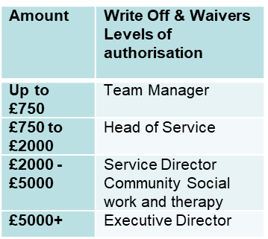
The “New” Waiver Process
For all waiver requests, the following process applies:
Note – Before submitting a waiver request, ensure that Disability Related Expenditure has been considered and, if necessary, a referral has been made to the Benefits team.
The full process is included within the Financial Waiver Procedure document.
Complete Waiver Form in Mosaic
Before sending for approval, ACFS check waiver amounts & confirm.
Allocate the form, for approval, based on the total waiver amount
Request reviewed and approved / denied.
TM to review and add comments

Slide 11

Completing the Waiver Request Form in Mosaic….
Victoria Boik

Slide 12
Timeline / Next Steps
24th, 25th March & 1st April | Community Team Briefing Sessions
Wc 6th April | Waiver Form Live in Mosaic.
 | Briefing sessions – ACFS, Appointee & Deputyship + any other teams who may request waivers.
 | ASC Charging Policy, Hardship and Financial Appeals processes are live.
 | Guidance & procedure documents available, including guidance for waiver approvers.
Date TBC | Waiver reporting (approved & pending) to be made available within the BI Hub.
Notes:
Launch dates etc – mention that documentation will be available in policy library – links to all documents / guidance and other info to be shared with these slides, when available.
We will also be creating some template letters to support communication in relation to waiver request outcomes.

Slide 13

Further Guidance & Information
Further information about the financial waiver process,
procedures and guidance will be available within the ASCH
Policy Library:
Financial Waivers Guidance – Link to follow
Financial Waivers Procedure (including how to complete the waiver form in Mosaic) – Link to follow
Financial Waivers Approval Procedure – Link to follow
Information relating to Financial Hardship, the Financial Appeals Process and Complaints, can be found at:
Complaints and Information | Nottinghamshire County Council Intranet
ASCH Charging Policy –
Hardship Form & Guidance –
Adult Social Care Charging Policy 2026-27
Flat Rate Charge Financial Hardship Form.docx

Slide 14


